Slide 1
COMP 4500
Week 11 - Monday

Slide 2
Last time
What did we talk about last time?
Polynomial-time reductions

Slide 3
Questions?

Slide 4
Assignment 6

Slide 5
Logical warmup
A businesswoman has two cubes on her desk
Every day she arranges both cubes so that the front faces show the current day of the month
What numbers do you need on the faces of the cubes to allow this?
Note: Both cubes must be used for every day
3

Slide 6
Three-sentence Summary of Reductions via Gadgets and Efficient Certification

Slide 7
Reductions via Gadgets

Slide 8
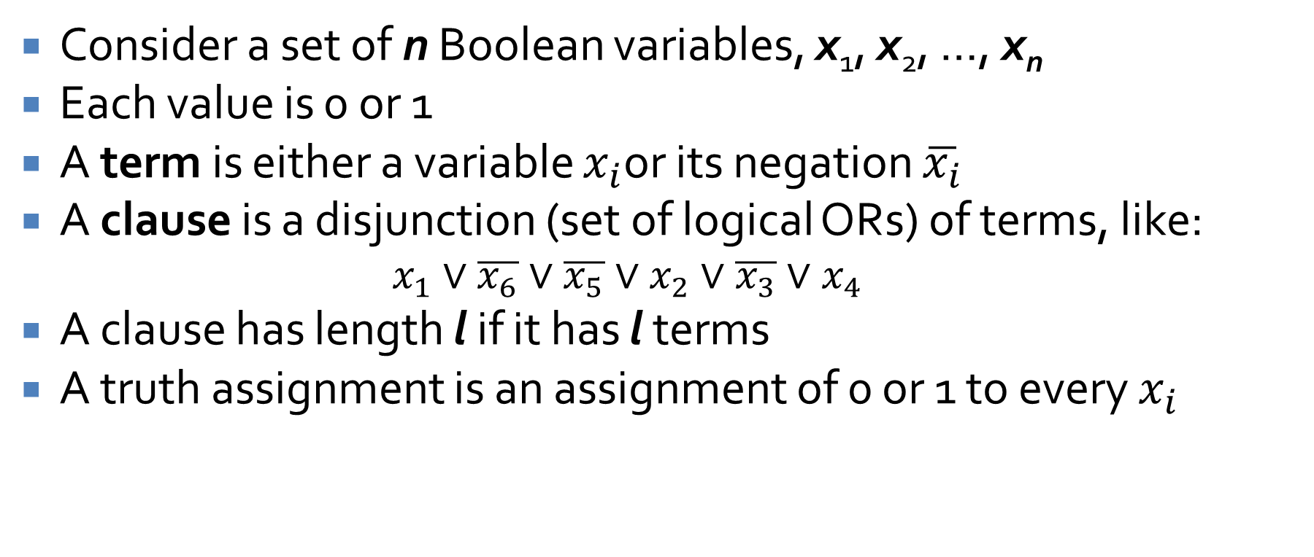
SAT and 3-SAT
Consider a set of n Boolean variables, x₁, x₂, …, x_{n}
Each value is 0 or 1
A term is either a variable $x_{i}$or its negation $\overline{x_{i}}$
A clause is a disjunction (set of logical ORs) of terms, like:
$$x_{1}∨\overline{x_{6}}∨\overline{x_{5}}∨x_{2}∨\overline{x_{3}}∨x_{4}$$
A clause has length l if it has l terms
A truth assignment is an assignment of 0 or 1 to every $x_{i}$

Slide 9
Satisfiability
A clause is satisfied if a truth assignment evaluates it to true
A collection of clauses is satisfied if a truth assignment satisfies each clause
Another way to view satisfiability is that, given clauses C₁, C₂, …, C_{k}, the following statement evaluates to true with some truth assignment:
$$C_{1}∧C_{2}∧…∧C_{k}$$

Slide 10
Satisfiability example
Consider the following three clauses:
$$\left(x_{1}∨\overline{x_{2}}\right),\left(\overline{x_{1}}∨\overline{x_{3}}\right),\left(x_{2}∨\overline{x_{3}}\right)$$
Can you find an assignment of 0 and 1 to each of the three variables such that all three clauses evaluate to true (1)?

Slide 11
Satisfiability
The satisfiability problem (SAT):
Given a set of clauses C₁, C₂, …, C_{k} over a set of variables {x₁, x₂, …, x_{n}}, is there a satisfying truth assignment?
The 3-satisfiability problem (3-SAT) is a special case of SAT in which all clauses have exactly three terms:
Given a set of clauses C₁, C₂, …, C_{k}, each of length 3, over a set of variables {x₁, x₂, …, x_{n}}, is there a satisfying truth assignment?

Slide 12
Reducing 3-SAT to independent set
Can we reduce 3-SAT to independent set?
The problems seem completely different:
Assigning true or false to Boolean variables
Picking vertices that are not neighboring
We need some glue that can tie together these two (seemingly) different problems
Enter: gadgets
In this case, we're going to build Boolean constraints into the nodes and edges of a graph

Slide 13
3-SAT ≤_{P} independent set
Proof:
We have a black box for independent set and want to solve an instance of 3-SAT consisting of variables {x₁, x₂, …, x_{n}} and clauses C₁, C₂, …, C_{k}.
Because terms are ORed together in clauses, we only need to pick one term per clause to be true
We need to pick one that doesn't have a conflict with a term in another clause.
A term has a conflict if it is the negation of the term we pick.

Slide 14
Proof continued
Construct a graph with 3k nodes grouped into k triangles such that each triangle contains nodes corresponding to each term in a clause, each connected by edges.
In other words, for i = 1, 2,…, k, we construct vertices v_{i1}, v_{i2}, v_{i3}, joined by edges.
Each vertex is labeled v_{ij}, meaning term j from clause C_{i}.
No vertices in an independent set are joined to each other; thus, no two vertices in each clause could be in the independent set.

Slide 15
Proof continued
Although we have guaranteed that no two terms in a clause will be part of an independent set, we have not prevented conflicts.
For each two terms that conflict, we add an edge between them as well.
We claim that the original 3-SAT instance is satisfiable if and only if the graph we constructed has an independent set of size at least k.

Slide 16
Proof continued
If the 3-SAT instance is satisfiable, each triangle in our graph contains at least one node whose label evaluates to 1. Let S be a set consisting of one such node from each triangle.
S is independent, because if there were an edge between two nodes u, v $∈$ S, the labels of u and v would conflict, but that can't happen, since they both evaluate to 1.

Slide 17
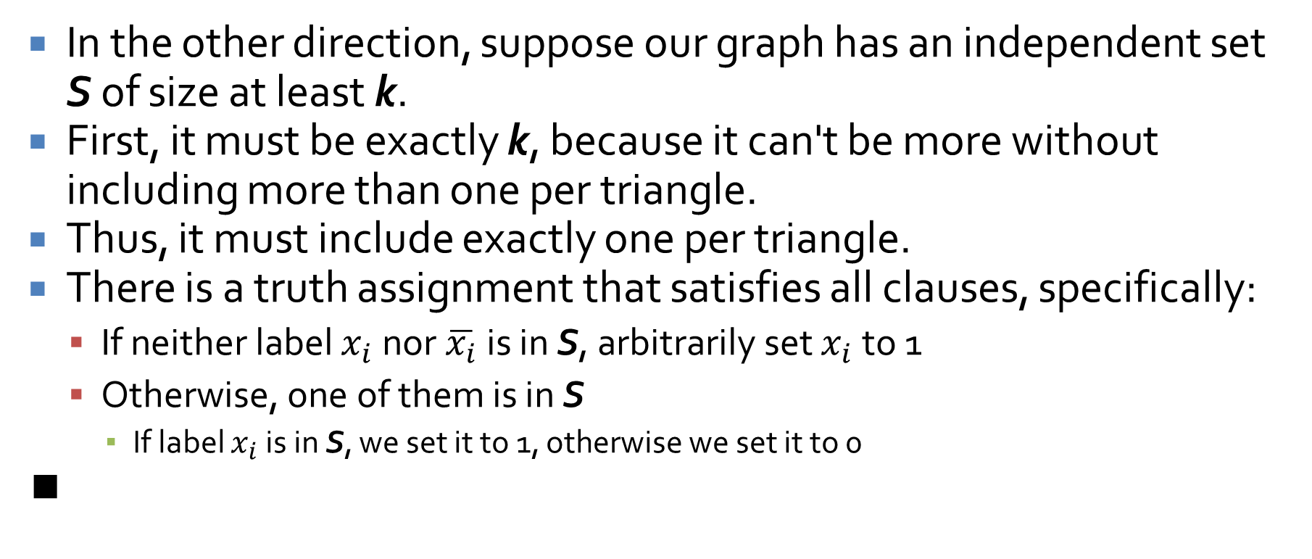
Proof continued
In the other direction, suppose our graph has an independent set S of size at least k.
First, it must be exactly k, because it can't be more without including more than one per triangle.
Thus, it must include exactly one per triangle.
There is a truth assignment that satisfies all clauses, specifically:
If neither label $x_{i}$ nor $\overline{x_{i}}$ is in S, arbitrarily set $x_{i}$ to 1
Otherwise, one of them is in S
If label $x_{i}$ is in S, we set it to 1, otherwise we set it to 0
∎

Slide 18
Observations about reductions
Every NP-complete problem has had other NP-complete problems reduced to it
Coming up with clever gadgets that allow the reduction is hard
Countless papers proposing gadgets have been published
Reductions are transitive
If Z ≤_{P} Y and Y ≤_{P} X, then Z ≤_{P} X

Slide 19
Efficient Certification

Slide 20
What makes a problem NP?
Is there something that sets apart problems that are NP-complete from other problems that (probably) take exponential time?
Yes!
It's easy to prove that you have an answer for one
In other words, they're easy to check

Slide 21
Checking
Does this graph have an independent set of size at least k?
If you show me a set of vertices, claiming they're independent, it's easy to check that they are
Can this 3-SAT be satisfied?
If you give me a truth assignment to variables, it's easy to check that every clause is true
Can you put a set of objects with at least value v into this knapsack?
If you show me the objects, it's easy to check that they have the given value and fit in the knapsack
It's hard to find these solutions, but they're easy to check!

Slide 22
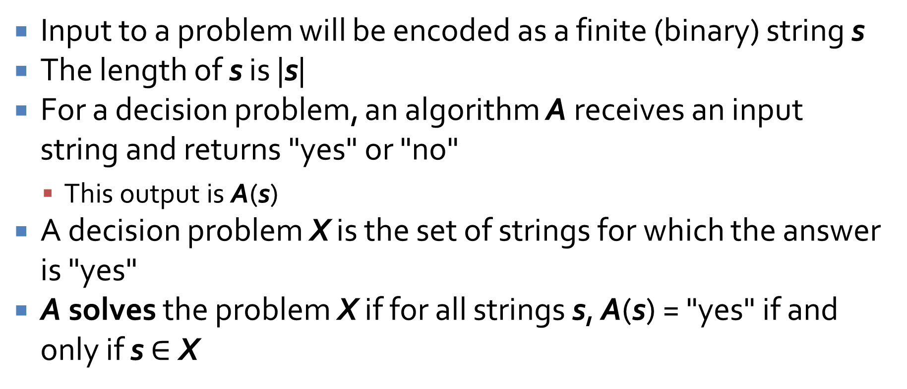
Problems and algorithms
Input to a problem will be encoded as a finite (binary) string s
The length of s is |s|
For a decision problem, an algorithm A receives an input string and returns "yes" or "no"
This output is A(s)
A decision problem X is the set of strings for which the answer is "yes"
A solves the problem X if for all strings s, A(s) = "yes" if and only if s $∈$ X

Slide 23
The class of problems P
Formally, an algorithm A has polynomial running time if
There is a polynomial function p(x)
Such that, for every input string s, the algorithm A terminates on s in at most O(p(|s|)) steps
Thus, P is the set of all decision problems X for which there is an algorithm A with polynomial running time that solves X

Slide 24
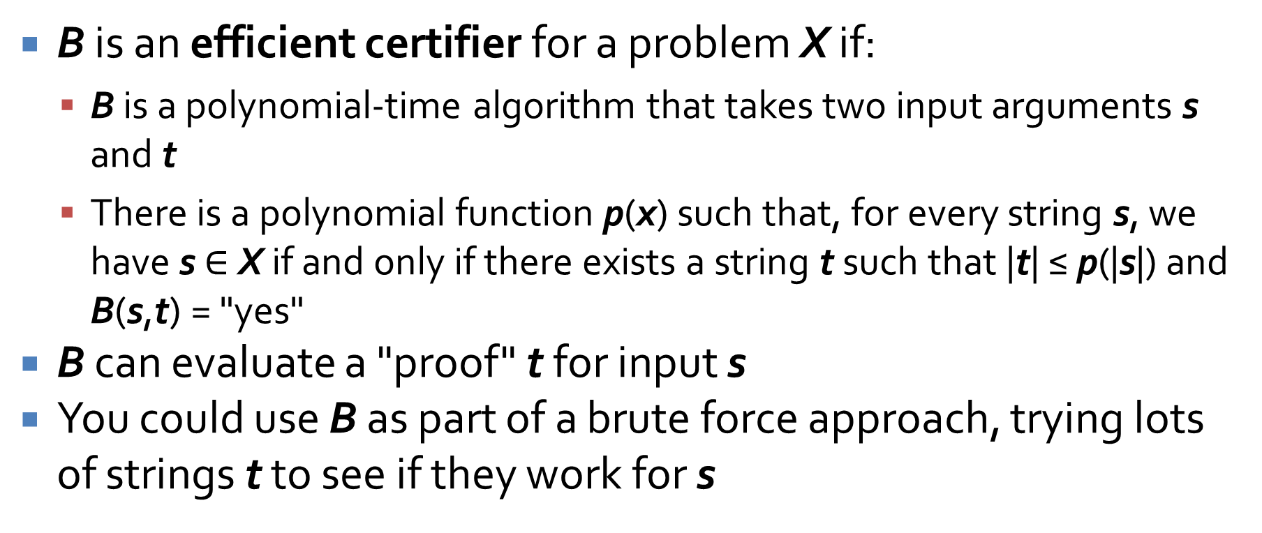
Efficient certification
B is an efficient certifier for a problem X if:
B is a polynomial-time algorithm that takes two input arguments s and t
There is a polynomial function p(x) such that, for every string s, we have s $∈$ X if and only if there exists a string t such that |t| ≤ p(|s|) and B(s,t) = "yes"
B can evaluate a "proof" t for input s
You could use B as part of a brute force approach, trying lots of strings t to see if they work for s

Slide 25
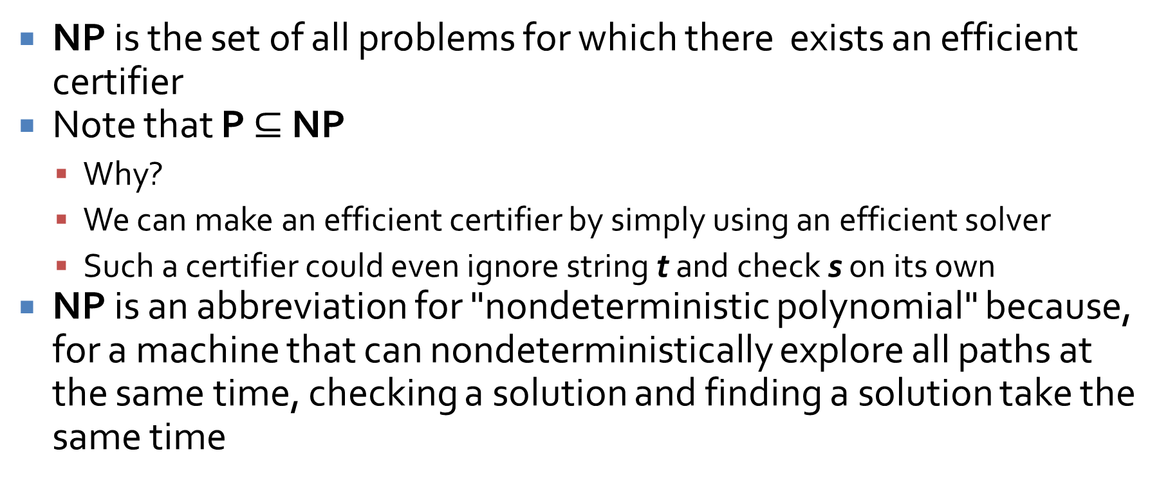
The class of problems NP
NP is the set of all problems for which there exists an efficient certifier
Note that P $⊆$ NP
Why?
We can make an efficient certifier by simply using an efficient solver
Such a certifier could even ignore string t and check s on its own
NP is an abbreviation for "nondeterministic polynomial" because, for a machine that can nondeterministically explore all paths at the same time, checking a solution and finding a solution take the same time

Slide 26
P = NP?
Is there a problem in NP that is not in P?
Many computer scientists believe that this is true
All NP-complete problems are believed to be too hard to solve in polynomial time
Other problems like factoring might not be as hard as NP-complete but might not be in P either
People have tried really hard to solve NP-complete problems in polynomial time…and failed

Slide 27
Thoughts about NP
If P=NP, then the world would be a profoundly different place than we usually assume it to be. There would be no special value in “creative leaps,” no fundamental gap between solving a problem and recognizing the solution once it’s found. Everyone who could appreciate a symphony would be Mozart; everyone who could follow a step-by-step argument would be Gauss; everyone who could recognize a good investment strategy would be Warren Buffett. It’s possible to put the point in Darwinian terms: if this is the sort of universe we inhabited, why wouldn’t we already have evolved to take advantage of it?
Scott Aaronson

Slide 28
Upcoming

Slide 29
Next time…
Proving problems NP-complete
Review

Slide 30
Reminders
Work on Assignment 6
Read Section 8.4

